Slide 1

Creating Ensemble Synergy
How to Plan and Actualize
a Synergistic Choral Rehearsal with
a Functional Unity Foundation for Singing
Pennsylvania Music Educators Conference, April 21, 2023
Jeffrey S. Gemmell, D.M.A., presenter
Blog: gemmell-posts.com
Notes:
Hello and welcome to “Loop the Loop!”

Slide 2

Let’s begin with music.
Long live music!

Slide 3

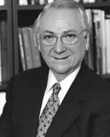
Philosophical Foundation
Philosophy: Our map, compass, guidance system
Bennett Reimer: Music Education as Aesthetic Education
“The skillful teacher will help students get closer and
closer to the sounds of the music, so that the sounds
themselves—the tone conditions of melody, harmony,
rhythm, tone color, texture, form, which embody
musical meaning—can exert their affective power”
Bennett Reimer (1932-2013), A Philosophy of Music Education, 1989, p. 96.

Slide 4
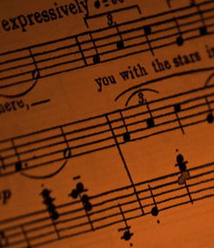
What is Music?
Material (musical elements) organized to be expressive (meaningful)
Melody
Rhythm
Harmony
Form
Dynamics
Timbre
Etc.

Slide 5
Simply put…
Synergy: the whole is greater than the sum of its parts
Score Preparation: Text + Context + SHMRF
  Text: explore meaningful textual-musical connections
  Context: research extra-musical information; performance practice
  Sound: devise an aural image of the work
  Harmony: hear the vertical structures
  Melody: sing each part on solfege to internalize pitches
  Rhythm: isolate/devise means to teach rhythm (count-sing)
  Form: map overall structure to navigate efficient rehearsals

Slide 6
General To-Do:
Know your score and Lesson Plan
Strive to keep the choir singing
Listen! Repeat for a reason
Use directives of five to seven words
Refine musicianship
Refine vocal technique
Make music! Once again with feeling!

Slide 7

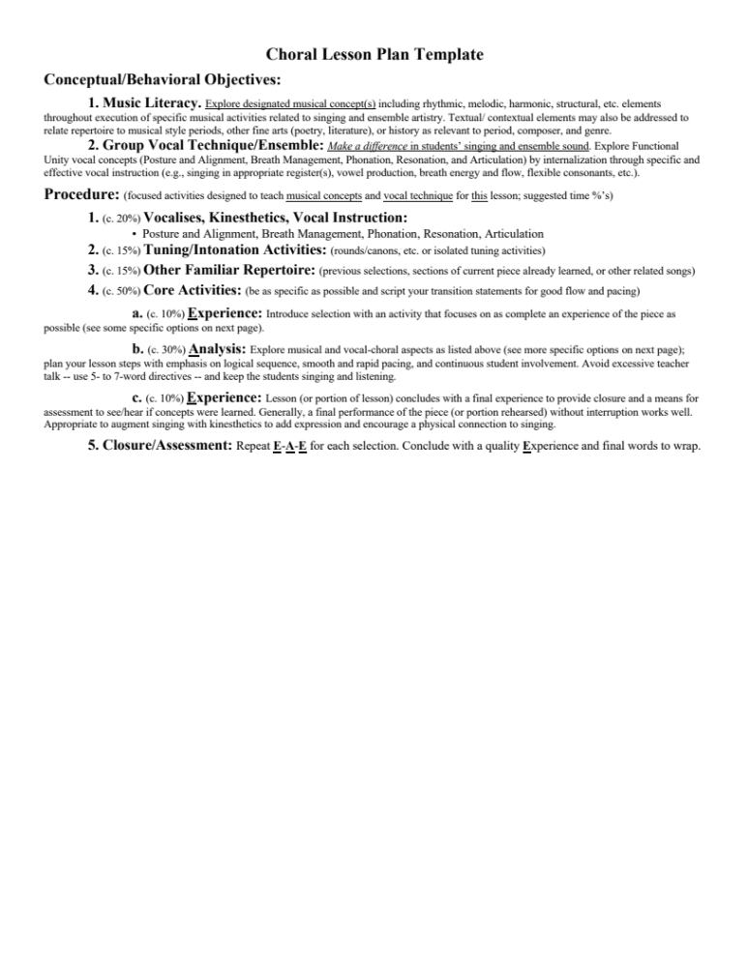

Slide 8
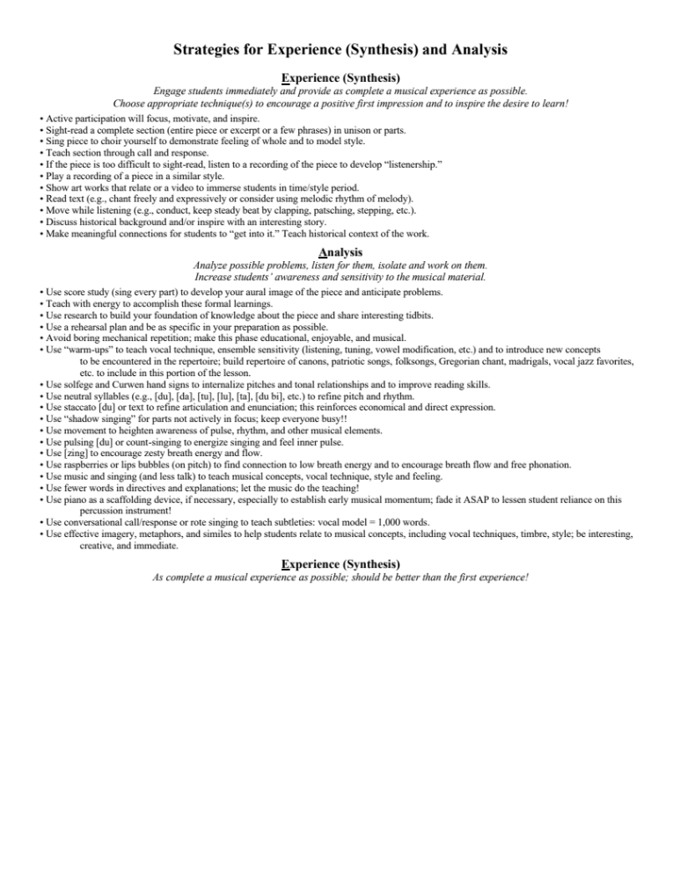

Slide 9
Why Teach Vocal Technique?
Every art consists of a technical-mechanical part and an aesthetical part. A singer who cannot overcome the difficulties of the first can never attain perfection in the second, not even a genius. (Mathilde Marchesi, 1821-1913)
When the voice works as a functional unit, it allows singers to develop an extended range with an even scale, a seamless legato, secure intonation regardless of vowel, tessitura, and dynamic, sufficient transmission or projection of sound and a wide palette of colors. These are the sensuous building blocks of their art …. to achieve the gestalt or functional unity of the singing voice is the goal of all singers. (Barbara Doscher, 1922-1996)

Slide 10
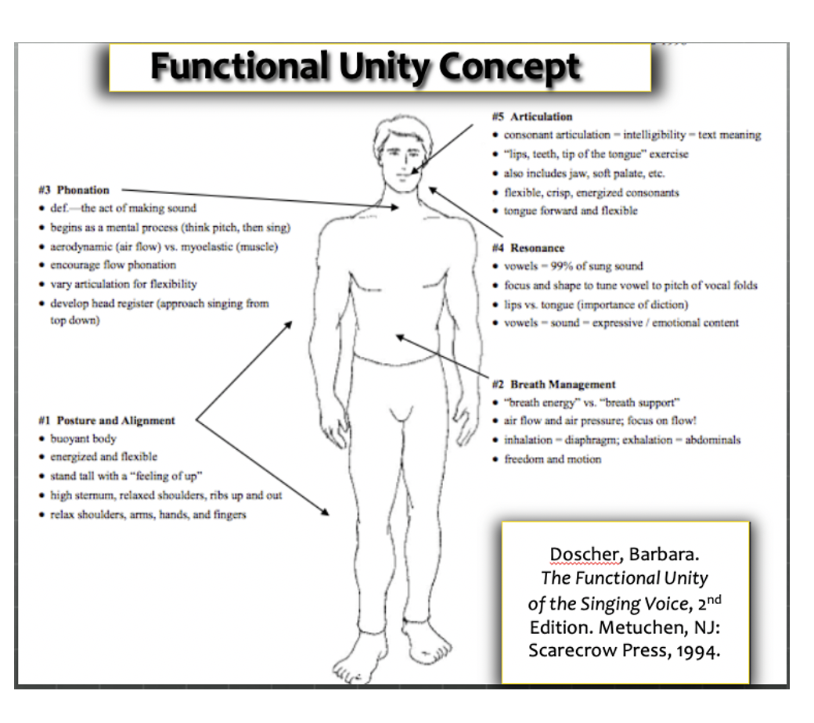

Slide 11
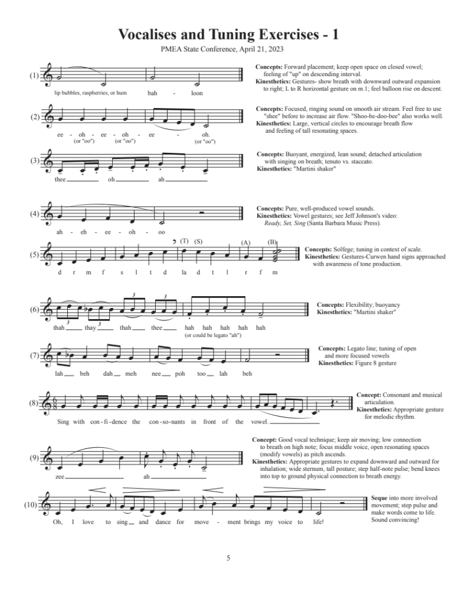

Slide 12
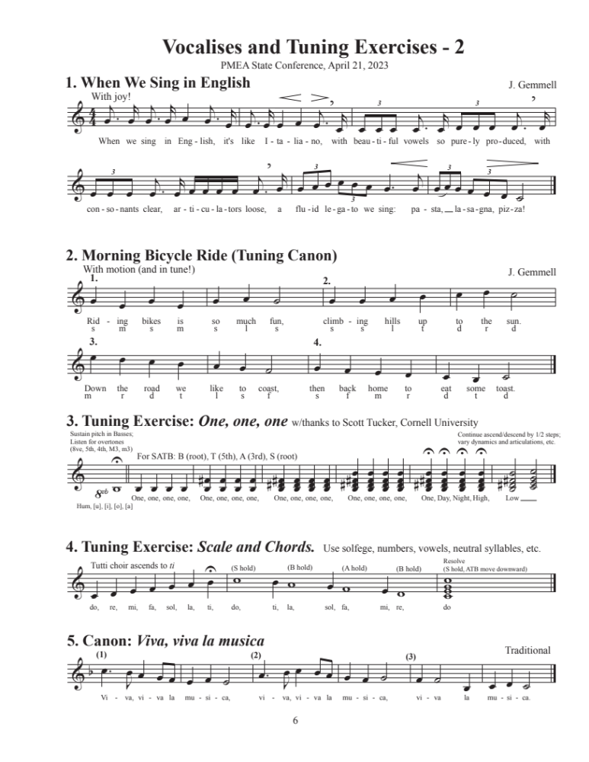

Slide 13

Musical Expression and Movement
The Dalcroze Approach is an effective way to interact with music…
Musical line (expressive energy) flows through time and space via sound and feeling.
Kinesthetics are a way to engage, channel, reflect and
communicate this energy.

Slide 14
Guidelines for Movement: Exploration and Discovery
Be centered and balanced. Anticipate movement and think ahead.
Be ready! Use balls of feet, not heels. Step artistically, like a dance.
Feel connection to your “core” – a buoyant center of support and breath energy.
Use your eyes to communicate, your animated face to express yourself, and your ears to listen. Share your sound (and feelings).
Balance upper body with lower body to for inner harmony and flow.
Have movements remain music-centered, mindful and artful. Use your thoughts and feelings to guide your physical actions.

Slide 15
Let’s Get Moving!
The Movement/Singing Cycle
Begin with gestures, proceed to movement in place, then movement in space
Ready
Preparation (Breath)
Initiation
Travel (feel musical flow through gesture/movement)
Sustain
Release

Slide 16
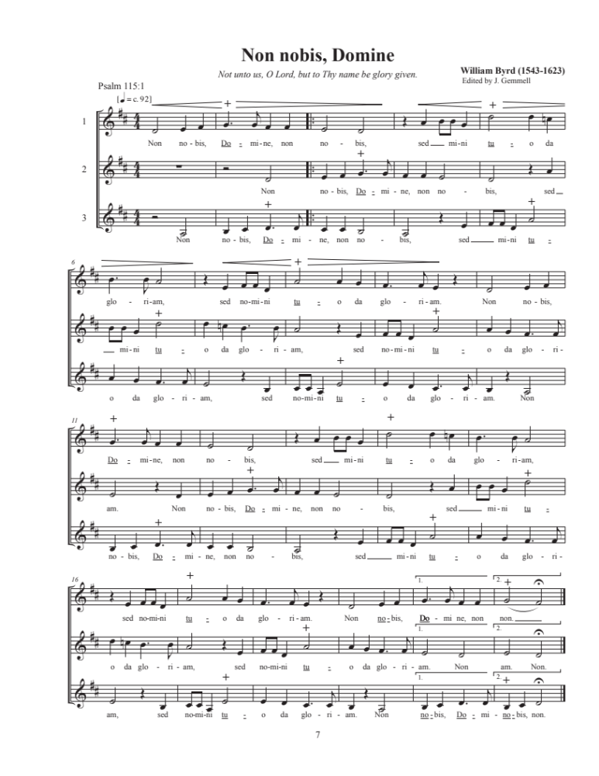

Slide 17
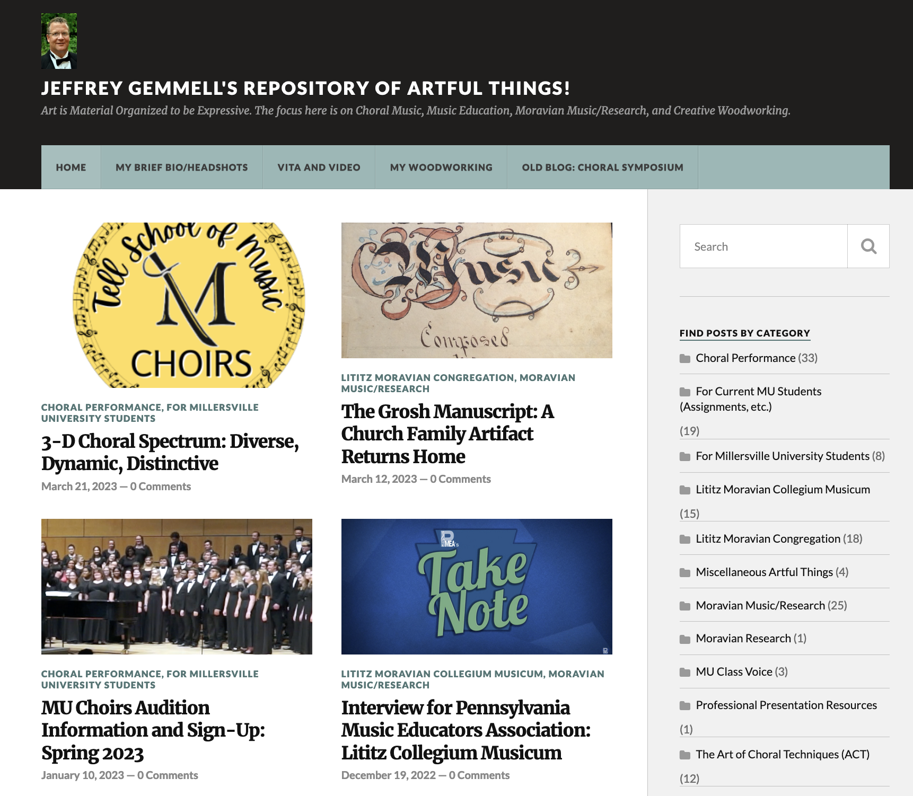
https://gemmell-posts.com

